Slide 1
The Memory System
Unit 5

Slide 2
Basic Concepts
Memory refers to the physical devices used to store instructions to execute programs.
Memory in a computer system is required for storage and retrieval of instructions and data.
Basic objective of a memory system is to provide fast uninterrupted access by the processor to the memory such that the processor can operate at the speed it is expected to work.

Slide 3
Connection of memory to Processor
From the system standpoint, the Main Memory (MM) unit can be viewed as a “block box”.
Data transfer between CPU and MM takes place through the use of two CPU registers, usually called MAR (Memory Address Register) and MDR (Memory Data Register).
If MAR is K bits long and MDR is ‘n’ bits long, then the MM unit may contain upto 2k addressable locations and each location will be ‘n’ bits wide, while the word length is equal to ‘n’ bits.
During a “memory cycle”, n bits of data may be transferred between the MM and CPU.

Slide 4
This transfer takes place over the processor bus, which has k address lines (address bus), n data lines (data bus) and control lines like Read, Write, Memory Function completed (MFC), Bytes specifiers etc (control bus).
For a read operation, the CPU loads the address into MAR, set READ to 1 and sets other control signals if required.
The data from the MM is loaded into MDR and MFC is set to 1.
For a write operation, MAR, MDR are suitably loaded by the CPU, write is set to 1 and other control signals are set suitably. The MM control circuitry loads the data into appropriate locations and sets MFC to 1. This organization is shown in the following block schematic

Slide 5
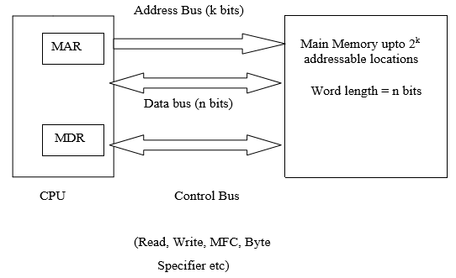

Slide 6
Characteristics of Memory
The main characteristics of memory are as follows:
Access Time: for RAM, this is the time it takes to perform a read or write operation.
Seek time: this is the time to position the head on specific track. On a fixed head disk it is the time taken by electronic circuit to select the required head while in movable disk it is the time to required move the head to a particular track.
Latency time: time required by a sector to reach below read write head. On an average it is half of the time taken for a rotation of the disk.

Slide 7
4. Cycle Time: memory cycle time is the access time ( to perform read/write operation) plus any additional time required before a second access occurs. But for most of the commonly used semiconductor memories cycle time is equal to access time
5. Data Transfer Rate: amount of information that can be transferred in or out of the memory in a second is termed as data transfer rate or bandwidth. It is measured in bits per second.

Slide 8
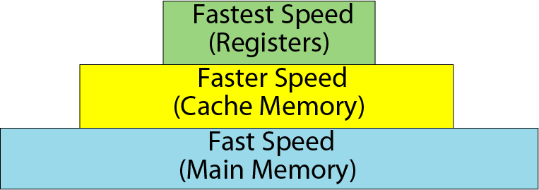
Memory hierarchy
Speed
Cost
Space
Secondary Memory

Slide 9
Memory hierarchy…
1. Registers: registers are normally at the top of the memory hierarchy, and provide the fastest way to access data.
Registers are very high-speed storage areas located inside the CPU.
2. Cache Memory: cache memory provides very fast accessing of data. This is positioned between CPU and main memory to reduce the internal accessing gap or time between CPU and main memory.
Cache memory is intended to speed up the access time and at the same time provide larger capacity at least price.
3. Main Memory/ Primary memory: these memories occupy third position in memory hierarchy. The data and instruction requires to be processed earlier reside in main

Slide 10
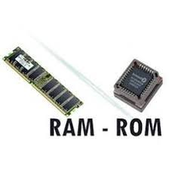
memory. These are the memory unit that communicates directly with the CPU.
Types of Main Memory:
RAM: the user can write information into RAM and read information from it. The content of RAM are lost when power supply is removed. This property is referred to as volatility.
ROM: ROM is an acronym for read-only memory. A read only memory stores information permanently, even in the absence of power and so it is called non-volatile memory. The information stored in it can only be read. It is not possible to write fresh
information into a ROM.

Slide 11
4. Secondary Memory / Auxiliary memory: this type of memory is also known as external memory and is slower than main memory.
These are used for storing Data/Information permanently. CPU directly does not access these memories instead they are accessed via IO routines. These devices provide backup facilities.
These are also known as Auxiliary found in large main frame or supercomputer and is not addressable directly by the CPU, and is connected to main memory by high speed data channel.

Slide 12
Types of Secondary Storage devices:
(i) Magnetic Storage Media: the magnetic media uses magnetic material for storage. There can be various types of magnetic media like:
1. Magnetic Tape
2. Hard Disk
3. Floppy Disk
(ii) Optical Storage Media: These devices use optics or laser beams. A pin point laser beam is used to burn tiny holes on the reflective platter disk. Some of the optical devices are:
1. Compact Disk (CD)
2. Digital Video Disk (DVD)

Slide 13
Organization Of Memory
Memory cells are usually organized in the form of an array, in which each cell is capable of storing one bit of information.
Each row of cells constitutes a memory word, and cells of a row are connected to a common line referred to as the word line, which is driven by the address decoder on the chip.
The cells in each column are connected to a sense/write circuit by two bit lines.
The sense/write circuits are connected to the data i/o line of the chip.
During a read operation, these circuits sense / read the information stored in the cells selected by a word line and transmit this information to the output data lines.
During a write operation, the sense/write circuits receive input information and store it in the cells of the selected word.

Slide 14
Internal organization of memory chips (Contd.,)
7
7
1
1
0
0
W
0
•
•
•
FF
FF
A
0
W
1
•
•
•
A
1
Address
Memory
decoder
•
•
•
•
•
•
•
•
•
•
•
•
•
•
•
•
•
•
cells
A
2
A
3
W
15
•
•
•
Sense / Write
Sense / Write
Sense / Write
R
/
W
circuit
circuit
circuit
CS
Data input
/output lines:
b
7
b
1
b
0

Slide 15
Summary: Internal organization of memory chips
Each memory cell can hold one bit of information.
Memory cells are organized in the form of an array.
One row is one memory word.
All cells of a row are connected to a common line, known as the “word line”.
Word line is connected to the address decoder.
Sense/write circuits are connected to the data input/output lines of the memory chip.

Slide 16
Organization of memory…
The data input and the data output of each sense/write circuit are connected to a single bidirectional data line that can be connected to the data bus of a computer .
Two control lines, R/W and CS(chip select), are provided in addition to address and data lines.
The R/W input specifies the required operation, and the CS input selected a given chip in a multichip memory system.

Slide 17
1K x 1 memory chip
The 1k(1024) memory cell chip can be organized as 128x8 memory, Requires 19 external connections.
Alternatively, same number of cells can be organized into a 1K x 1 format as shown in fig (next slide).
In this case, a 10 bit address is needed, but there is only one data line, resulting 15 external connections.
10 bit address is divided into two groups of 5 bits each to form a row and column address of cell array.
A row address selects a row of 32 cells, all of which are accessed in parallel.
However, according to the column address, only one of these cells is connected to the external data line by the output Multiplexer and input demultiplexer.

Slide 18
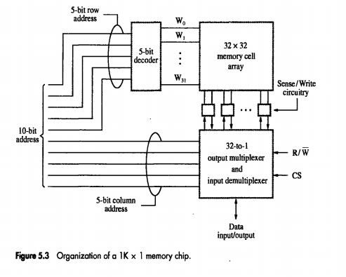
Organization of a 1k X 1 memory chip

Slide 19
Semiconductor RAM Memories

Slide 20
Static memories
Memories consist of circuits capable of retaining their state as long as power is applied are known as static memories.
Fig (in next slide) shows how static RAM (SRAM) cell implemented
Two inverters are crossed connected to form a latch.
The latch is connected to two bit lines by transistors t1 and t2.
The transistor acts as switches that can be opened or closed under control of the word line.
When the word line is at ground level the transistors are turned off and latch retains its state.

Slide 21
SRAM Cell
Two transistor inverters are cross connected to implement a basic flip-flop.
The cell is connected to one word line and two bits lines by transistors T1 and T2
When word line is at ground level, the transistors are turned off and the latch retains its state
b
′
b
T
T
1
X
Y
2
Word line
Bit lines

Slide 22
Read operation:
In order to read the state of the SRAM cell, the word line is activated to close switches T1 and T2.
If the cell is in state 1, the signal on bit line b is high and the signal on bit b¹ is low.
The opposite is true if the cell is in state 0.Thus, b and b¹ are complements of each other.
Sense/write circuits at the end of the bit lines monitor the state of b and b¹ and set the output accordingly.

Slide 23
Write operation:
The state of the cell is set by placing the appropriate value on bit line b and its complement on b^{l} , and then activating the word line.
This forces the cell into the corresponding state.
The required signals on the lines are generated by the sense/write circuit.

Slide 24
SRAM Vs DRAM
Static RAMs (SRAMs):
Consist of circuits that are capable of retaining their state as long as the power is applied.
Volatile memories, because their contents are lost when power is interrupted.
Access times of static RAMs are in the range of few nanoseconds.
However, the cost is usually high. Fast memory.
Dynamic RAMs (DRAMs):
Do not retain their state indefinitely.
Contents must be periodically refreshed.
Contents may be refreshed while accessing them for reading.

Slide 25
Asynchronous DRAMS
Static RAMs are fast, but they come at a high cost because their cells require several transistors.
Less expensive RAMs can be implemented if simpler cells are used. How-ever such cells do not retain their state indefinitely: hence they are called dynamic RAMs (DRAMs).

Slide 26
Asynchronous DRAMS…
Information is stored in a dynamic memory cell in the form of charge on a capacitor, and this charge can be maintained only for tens of milliseconds.
Since the cell is required to store information for a much longer time, its content must be periodically refreshed by storing the capacitor charge to its full value.

Slide 27
In order to store information in this cell, transistor T is turned on and an appropriate voltage is applied to the bit line. This causes a known amount of charge to be stored in the capacitor.

Slide 28
DRAM
After the transistor is turned off, the capacitor begins to discharge due to the capacitor’s own leakage resistance.
The transistor continues to conduct any tiny amount of current, even after it is turned off.
Hence information stored in the cell can be retrieved correctly only if it is read before the charge on the capacitor drops below some threshold value.

Slide 29
DRAM
During a Read operation, the transistor in a selected cell is turned on.
A sense amplifier connected to the bit line detects whether the charge stored on the capacitor is above the threshold value.
If it senses that it is below the threshold value, it pulls the bit line to ground level ensuring that the capacitor has no charge.
Thus, reading the contents of the cell automatically refreshes its contents.

Slide 30
Asynchronous DRAMs
Each row can store 512 bytes. 12 bits to select a row, and 9 bits to select a group in a row. Total of 21 bits.
First apply the row address, RAS signal latches the row address. Then apply the column address, CAS signal latches the address.
Timing of the memory unit is controlled by a specialized unit which generates RAS and CAS.
This is asynchronous DRAM
R
A
S
Row
Row
4096
×
(
512
×
8
address
)
latch
decoder
cell array
A
20
⁄
A
Sense / Write
CS
-
9
8
-
0
circuits
R
/
W
Column
Column
address
decoder
latch
C
A
S
D
D
7
0

Slide 31

During a READ/WRITE operation, the row address is applies first .
This address is loaded into the Row Address Latch in response to the RAS(Row Address Strobe).
Shortly after this, the CAS(Column Address Strobe) loads the column address into the Row Address Latch.

Slide 32
If the R/W control signal indicates a READ operation, the output values of the selected circuits are transferred to the data lines, D₇₋₀ .
WRITE operation, the information on the data lines, D₇₋₀ are transferred to the selected circuits.

Slide 33
In the DRAM, the timing of the memory is controlled Asynchronously.
A specialized memory controller circuit provides the necessary control signals, RAS and CAS, that govern the timing.
The processor must take into account the delay in the response of the memory

Slide 34
Synchronous DRAMs
Operation is directly synchronized
with processor clock signal.
The outputs of the sense circuits are
connected to a latch.
During a Read operation, the
contents of the cells in a row are
loaded onto the latches.
During a refresh operation, the
contents of the cells are refreshed
without changing the contents of
the latches.
Data held in the latches correspond
to the selected columns are transferred to the output.
Refresh
counter
Row
Ro
w
address
decoder
Cell array
latch
Row/Column
address
Column
Co
lumn
Read/Write
address
decoder
circuits & latches
counter
Clock
R
A
S
Mode register
C
A
S
and
Data input
Data output
R
/
W
timing control
register
register
C
S
Data

Slide 35
Read-Only Memories

Slide 36
ROM
Both SRAM and DRAM chips are volatile, which means that they lose the stored info if power is turned off.
There are many applications that need memory devices which retain the stored information if power is turned off.
There is another memory in computer, which is called Read Only Memory (ROM).
The storage of program and data in the ROM is permanent.
The ROM stores some standard processing programs supplied by the manufacturers to operate the computer.
The ROM can only be read by the CPU but it cannot be changed.

Slide 37
Read-Only-Memory
Bit line
Word line
T
Not connected to store
a 1
P
Connected to store a 0
Figure 5.12. A ROM cell.

Slide 38
From the fig5.12, shows a possible configuration for a ROM cell.
A logic value 0 is stored in cell if the transistor is connected to ground at point P. otherwise , a 1 is stored.
The bit line is connected through a resistor to the power supply.
To read the state of the cell, bit line drops to near zero if there is a connection between the transistor and ground. If there is no connection to ground, the bit line remains at high voltage, indicating a 1.
A sense circuit at the end of the bit line generates the proper output value.
Data are written into a ROM when it is manufactured.

Slide 39
PROM : is another type of primary memory in computer, which is called Programmable Read Only Memory (PROM).
You know that it is not possible to modify or erase programs stored in ROM, but it is possible for you to store your program in PROM chip. Once the programs are written it cannot be changed and remain intact even if power is switched off.
Programs or instructions written in PROM or ROM cannot be erased or changed.

Slide 40
EPROM:
Erasable Programmable Read Only Memory, which over come the problem of PROM & ROM.
EPROM chip can be programmed time and again by erasing the information stored earlier in it.
When the EPROM is in use information can only be read.

Slide 41
EEPROM:
A significant disadvantage of EPROMs is that a chip must be physically removed from the circuit for reprogramming and that its entire contents are erased by the ultraviolet light.
It is possible to implement another version of erasable PROMs that can be both programmed and erased electrically.
Such chips, are called EEPROM, do not have to be removed for erasure.
The only disadvantage of EEPROMs is that different voltages are needed for erasing, writing and reading the stored data.

Slide 42
Flash Memory

Slide 43
Flash Memory
An approach similar to EEPROM technology is flash memory devices.
A flash device it is possible to read the contents of a single cell, but it is only possible to write an entire block of cells.
Prior to writing, the previous contents of the block are erased.
Flash devices have greater density, which leads to higher capacity and a lower in their operation.
Flash memories are low power consumption, used in portable equipment that is battery driven.
Typical applications include hand held computers, cell phones, digital cameras, and MP3 music players.

Slide 44
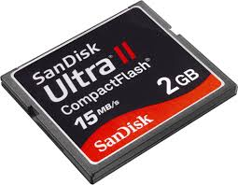
Flash memory…
Single flash chip do not provide sufficient storage capacity for the applications mentioned in previous slide.
Larger memory modules consisting of a number of chips are needed.
There are two popular choices . They are:
1. Flash cards
2. Flash drives.
Flash Cards: one way of constructing a larger module is to mount flash chips on a small card, called flash card.
Flash cards come in variety of memory sizes. Typical size like 8, 32, and 64 MB.

Slide 45

Flash drives: larger flash memory modules have been developed to replace hard disk drives.
These flash drives are designed to fully emulate(copy) the hard disk.
Storage capacity of flash drives is lower compare to hard disk.
Advantage:
shorter seek and access time.
faster response.
Low power consumption.
Disadvantage:
Smaller capacity and higher cost per bit.

Slide 46
Cache Memory

Slide 47
Cache Memory
The speed of CPU is extremely high compared to the access time of main memory.
Therefore the performance of CPU decreases due to the slow speed of main memory.
Cache Memory is a small memory chip is attached between CPU and Main memory whose access time is very close to the processing speed of CPU.
CACHE memories are accessed much faster than conventional RAM. It is used to store programs or data currently being executed or temporary data .

Slide 48
Cache
Main
Processor
Cache
memory
Figure 5.14. Use of a cache memory.

Slide 49
Virtual Memory

Slide 50
Virtual Memories
Physical main memory is not as large as the address space spanned by an address issued by the processor.
2³² = 4 GB, 2⁶⁴ = …
When a program does not completely fit into the main memory, the parts of it not currently being executed are stored on secondary storage devices like magnetic disks.
Techniques that automatically move program and data blocks into the physical main memory when they are required for execution are called virtual-memory techniques.
Virtual addresses will be translated into physical addresses

Slide 51
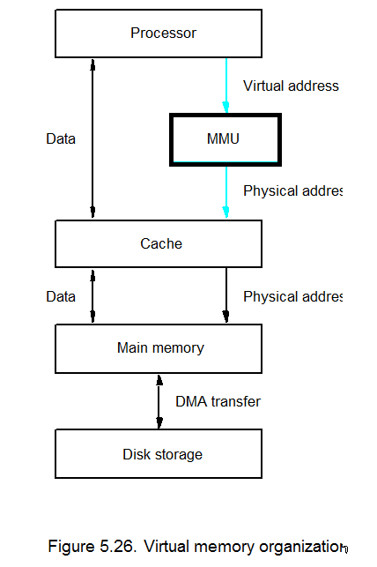
Memory Management Unit

Slide 52
Virtual memory…
Fig.5.26 shows a typical organization that implements virtual memory.
A special hardware unit, called Memory management Unit (MMU), translates virtual addresses into physical addresses.
When the desired data or instructions are in the main memory, these data are fetched.
The MMU causes the operating system to bring the data into the memory from the disk.
Transfer of data between the disk and main memory is performed using the DMA scheme.

Slide 53
End of Unit 5

